Slide 1

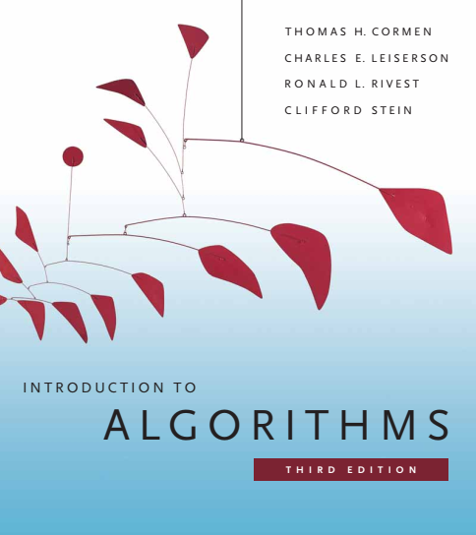
Design and Analysis of Algorithms
Dr. Sajid Iqbal
sajidiqbal.pk@gmail.com
Reference Book
Introduction to Algorithms 3rd Edition By Thomas H. Cormen et. al.
https://mitpress.mit.edu/books/introduction-algorithms-third-edition
COMEDXD

Slide 2
Counting Sort
A Non-Comparison sort

Slide 3

Introduction
This sort assumes that all input elements ($n$) lie in the range $0−k$ for some integer $k$
This sort runs in θ(n) time
Working
For each input element $x$, algorithm finds number of elements less than $x$
Then it places $x$ in its proper position in output array
i.e. there are $7$ elements less than $x$, then $x$ will be placed at 8th position in output array
1 | 2 | 3 | 4 | 5 | 6 | 7 | 8 | 9 | 10
 |  |  |  |  |  |  | 8

Slide 4
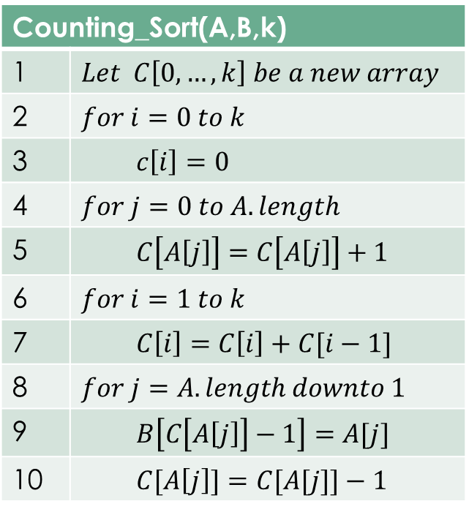

Counting Sort
Lines 1-3: initialize an array $C$ with 0-values that will contains the count of $i^{th}$ elements on $i^{th}$ index.
Lines 4-5: Inspect each input element. If the value of input element is $i$, increment $C[i]$. $C[i]$ contains the count of elements which are equal to $i$
Lines 6-7: count that how many elements are less than $i$. by keeping the running sum of array $C$
Lines 8-10: Place each $j^{th}$ element of $A$ in its correct position in $B$. Two possibilities occur
Elements in $A$ are distinct: The case is simple place each $j^{th}$ element of A in $j^{th}$ position of $B$
Elements in $A$ are not Distinct: Place the $j^{th}$ element of $A$ in $B$ and decrement the count of that number in $C$
Counting_Sort(A,B,k)
1 | $$Let C\left[0,…,k\right] be a new array$$
2 | $$for i=0 to k$$
3 | $$c\left[i\right]=0$$
4 | $$for j=0 to A.length$$
5 | $$C\left[A\left[j\right]\right]=C\left[A\left[j\right]\right]+1$$
6 | $$for i=1 to k$$
7 | $$C\left[i\right]=C\left[i\right]+C[i−1]$$
8 | $$for j=A.length downto 1$$
9 | $$B\left[C\left[A\left[j\right]\right]−1\right]=A[j]$$
10 | $$C[A\left[j\right]]=C[A[j]]−1$$
0 | 1 | 2 | 3 | 4 | 5 | 6 | 7 | 8 | 9
0 | 0 | 0 | 0 | 0 | 0 | 0 | 0 | 0 | 0

Slide 5


Counting Sort Functioning
Let $A=[1,…,n]$ $A.length=n$
Let $B=[1,…,n]$is output array of same size as that of $A$
Find the maximum element in the array i.e. $k$
Lines 1-3: Initialize another array $C$ with size $k+1$ $C=\left[0,…,k+1\right]$
Lines 4-5: Store the count of each element at respective index in $C$
Lines 6-7: Store cumulative sum of the elements of the $C$ array
It helps in placing the elements into the correct index of the sorted array.
Lines 8-10: Find the index of each element of the $A$ array in the $C$ array. This gives the cumulative count. Place the element at the index calculated
Line 10: After placing each element at its correct position, decrease its count by one
Counting_Sort(A,B,k)
1 | $$Let C\left[0,…,k\right] be a new array$$
2 | $$for i=0 to k$$
3 | $$c\left[i\right]=0$$
4 | $$for j=0 to A.length$$
5 | $$C\left[A\left[j\right]\right]=C\left[A\left[j\right]\right]+1$$
6 | $$for i=1 to k$$
7 | $$C\left[i\right]=C\left[i\right]+C[i−1]$$
8 | $$for j=A.length downto 1$$
9 | $$B\left[C\left[A\left[j\right]\right]−1\right]=A[j]$$
10 | $$C[A\left[j\right]]=C[A[j]]−1$$

Slide 6
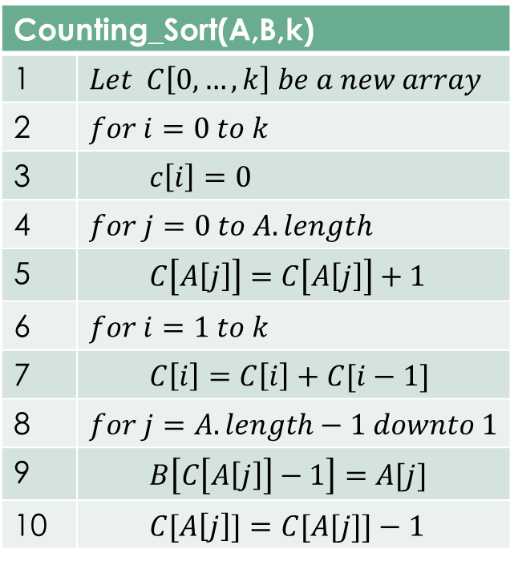
Step by Step Description
Lines 1-3
A | idx | 0 | 1 | 2 | 3 | 4 | 5 | 6 | 7
 | Val | 2 | 5 | 3 | 0 | 2 | 3 | 0 | 3
B | Idx | 0 | 1 | 2 | 3 | 4 | 5 | 6 | 7
 | Val | 0 | 0 | 0 | 0 | 0 | 0 | 0 | 0
C | Idx | 0 | 1 | 2 | 3 | 4 | 5
 | Val | 0 | 0 | 0 | 0 | 0 | 0
Lines 4-5
Counting_Sort(A,B,k)
1 | $$Let C\left[0,…,k\right] be a new array$$
2 | $$for i=0 to k$$
3 | $$c\left[i\right]=0$$
4 | $$for j=0 to A.length$$
5 | $$C\left[A\left[j\right]\right]=C\left[A\left[j\right]\right]+1$$
6 | $$for i=1 to k$$
7 | $$C\left[i\right]=C\left[i\right]+C[i−1]$$
8 | $$for j=A.length−1 downto 1$$
9 | $$B\left[C\left[A\left[j\right]\right]−1\right]=A[j]$$
10 | $$C[A\left[j\right]]=C[A[j]]−1$$
C | Idx | 0 | 1 | 2 | 3 | 4 | 5
 | Val | 2 | 0 | 2 | 3 | 0 | 1
Lines 6-7
C | Idx | 0 | 1 | 2 | 3 | 4 | 5
 | Val | 2 | 2 | 4 | 7 | 7 | 8
Lines 8-10 iter-1
j=7
B 1 | Idx | 0 | 1 | 2 | 3 | 4 | 5 | 6 | 7
 | Val | 0 | 0 | 0 | 0 | 0 | 0 | 3 | 0
C | Idx | 0 | 1 | 2 | 3 | 4 | 5
 | Val | 2 | 2 | 4 | 6 | 7 | 8
Lines 8-10 iter-2
J=6
B 2 | Idx | 0 | 1 | 2 | 3 | 4 | 5 | 6 | 7
 | Val | 0 | 0 | 0 | 0 | 0 | 0 | 3 | 0
C | Idx | 0 | 1 | 2 | 3 | 4 | 5
 | Val | 1 | 2 | 4 | 6 | 7 | 8

Slide 7

A | idx | 0 | 1 | 2 | 3 | 4 | 5 | 6 | 7
 | Val | 2 | 5 | 3 | 0 | 2 | 3 | 0 | 3
Lines 8-10 iter-3
j=5
B 3 | Idx | 0 | 1 | 2 | 3 | 4 | 5 | 6 | 7
 | Val | 0 | 0 | 0 | 0 | 0 | 3 | 3 | 0
C | Idx | 0 | 1 | 2 | 3 | 4 | 5
 | Val | 1 | 2 | 4 | 5 | 7 | 8
Counting_Sort(A,B,k)
1 | $$Let C\left[0,…,k\right] be a new array$$
2 | $$for i=0 to k$$
3 | $$c\left[i\right]=0$$
4 | $$for j=0 to A.length$$
5 | $$C\left[A\left[j\right]\right]=C\left[A\left[j\right]\right]+1$$
6 | $$for i=1 to k$$
7 | $$C\left[i\right]=C\left[i\right]+C[i−1]$$
8 | $$for j=A.length downto 1$$
9 | $$B\left[C\left[A\left[j\right]\right]−1\right]=A[j]$$
10 | $$C[A\left[j\right]]=C[A[j]]−1$$
Lines 8-10 iter-4
J=4
B 4 | Idx | 0 | 1 | 2 | 3 | 4 | 5 | 6 | 7
 | Val | 0 | 0 | 0 | 2 | 0 | 3 | 3 | 0
C | Idx | 0 | 1 | 2 | 3 | 4 | 5
 | Val | 1 | 2 | 3 | 5 | 7 | 8
Lines 8-10 iter-5
J=3
B 5 | Idx | 0 | 1 | 2 | 3 | 4 | 5 | 6 | 7
 | Val | 0 | 0 | 0 | 2 | 0 | 3 | 3 | 0
C | Idx | 0 | 1 | 2 | 3 | 4 | 5
 | Val | 0 | 2 | 3 | 5 | 7 | 8
Lines 8-10 iter-6
J=2
B 6 | Idx | 0 | 1 | 2 | 3 | 4 | 5 | 6 | 7
 | Val | 0 | 0 | 0 | 2 | 3 | 3 | 3 | 0
C | Idx | 0 | 1 | 2 | 3 | 4 | 5
 | Val | 0 | 2 | 3 | 4 | 7 | 8
Lines 8-10 iter-7
J=1
B 7 | Idx | 0 | 1 | 2 | 3 | 4 | 5 | 6 | 7
 | Val | 0 | 0 | 0 | 2 | 3 | 3 | 3 | 5
C | Idx | 0 | 1 | 2 | 3 | 4 | 5
 | Val | 0 | 2 | 3 | 4 | 7 | 7
Lines 8-10 iter-8
J=0
B 8 | Idx | 0 | 1 | 2 | 3 | 4 | 5 | 6 | 7
 | Val | 0 | 0 | 2 | 2 | 3 | 3 | 3 | 5
C | Idx | 0 | 1 | 2 | 3 | 4 | 5
 | Val | 0 | 2 | 2 | 4 | 7 | 7

Slide 8
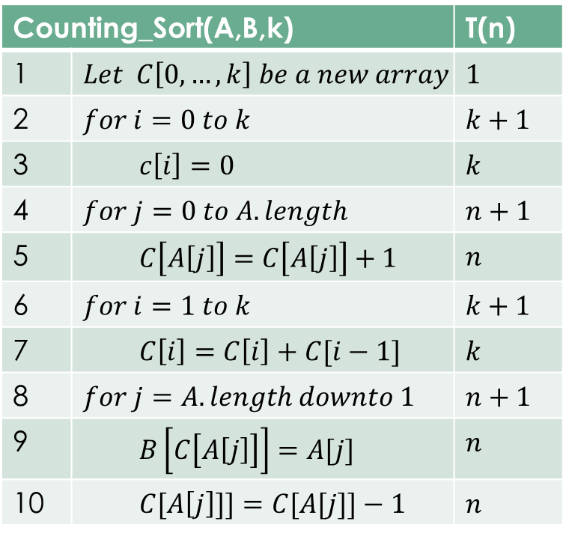
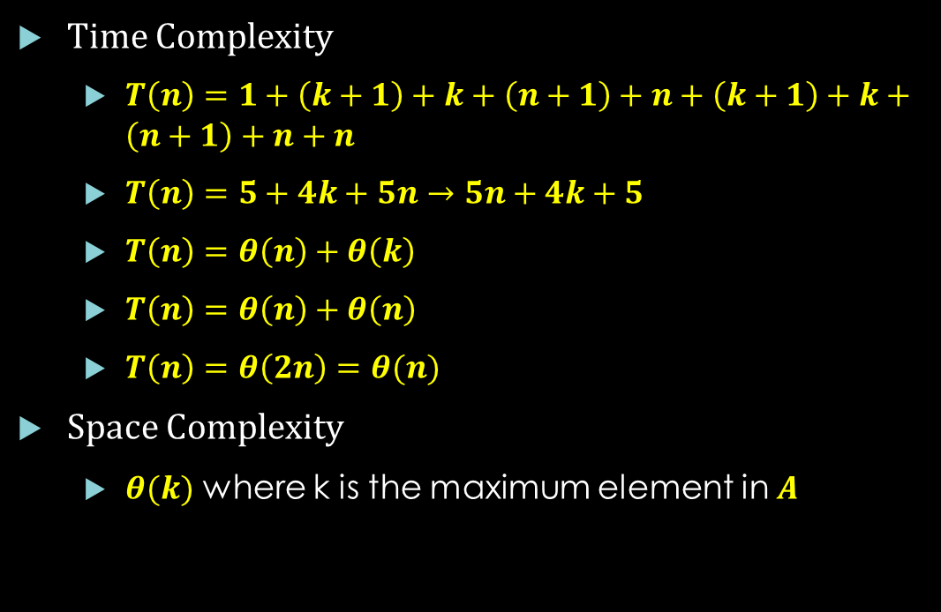
Analysis of Counting Sort
Time Complexity
$T\left(n\right)=1+\left(k+1\right)+k+\left(n+1\right)+n+\left(k+1\right)+k+\left(n+1\right)+n+n$
$T\left(n\right)=5+4k+5n→5n+4k+5$
$T\left(n\right)=θ\left(n\right)+θ\left(k\right)$
$T\left(n\right)=θ\left(n\right)+θ\left(n\right)$
$T\left(n\right)=θ\left(2n\right)=θ(n)$
Space Complexity
$θ(k)$ where k is the maximum element in $A$
Counting_Sort(A,B,k) |  | T(n)
1 | $$Let C\left[0,…,k\right] be a new array$$ | $$1$$
2 | $$for i=0 to k$$ | $$k+1$$
3 | $$c\left[i\right]=0$$ | $$k$$
4 | $$for j=0 to A.length$$ | $$n+1$$
5 | $$C\left[A\left[j\right]\right]=C\left[A\left[j\right]\right]+1$$ | $$n$$
6 | $$for i=1 to k$$ | $$k+1$$
7 | $$C\left[i\right]=C\left[i\right]+C[i−1]$$ | $$k$$
8 | $$for j=A.length downto 1$$ | $$n+1$$
9 | $$B\left[C\left[A\left[j\right]\right]\right]=A[j]$$ | $$n$$
10 | $$C[A\left[j\right]]]=C[A[j]]−1$$ | $$n$$

Slide 9

Analysis Counting Sort
Counting sort is not comparison sort and beats the lower bound $Ω\left(nlogn\right)$ of comparison sorts
Counting sort is stable sort
Numbers with the same value appear in the output array n the same order as they do in the input array
Counting sort works as subroutine for radix sort
It must be stable for proper working of counting sort

Slide 10

Stable Sort
Stability is important when we have key value pairs with possible duplicate keys
A sorting algorithm is said to be stable if two objects with equal keys appear in the same order in sorted output as they appear in the input array to be sorted
If $i<j$ and $A[i]=A[j]$then in output array for $i<j, B[i]$must come before $B[j]$
Equivalent elements retain their relative positions, after sorting
Stable sorting is useful when we use grouping in databases
10 | 20 | 10 | 30 | 20
10 | 10 | 20 | 20 | 30

Slide 11
Stability Example
Before Sorting | After Sorting
(Sajid,A) | (Asim,B)
(Nasir,B) | (Kamran,C)
(Zahid,A) | (Nasir,B)
(Kamran,C) | (Sajid,A)
(Zeeshan,A) | (Zahid,A)
(Asim,B) | (Zeeshan,A)

Slide 12
Python Implementation of Counting Sort
import numpy as np def Counting_Sort(A,B,k1): C = np.zeros(k1+1,np.int) for i in range(0, len(A)): C[A[i]] += 1 for i in range(1, k1+1): C[i] += C[i - 1] for j in range(len(A)-1,-1,-1): B[C[A[j]] - 1] = A[j] C[A[j]] = C[A[j]]-1 return B
# Driver Code
A=[2,5,3,0,2,3,0,3] B=np.zeros(len(A),np.int) B=Counting_Sort(A,B,max(A)) print("Sorted Array in Ascending Order: ") print(B)

Slide 13

Thanks for watching
Dr. Sajid Iqbal
Assistant Professor
Department of Computer Science
Bahauddin Zakariya University, Multan
sajidiqbal.pk@gmail.com
YouTube Channel: COMEDXD
Allah Hafiz

Slide 14
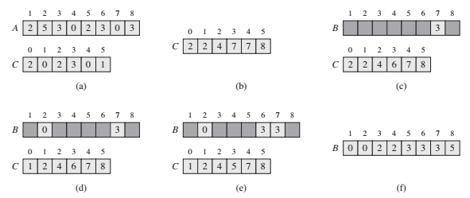
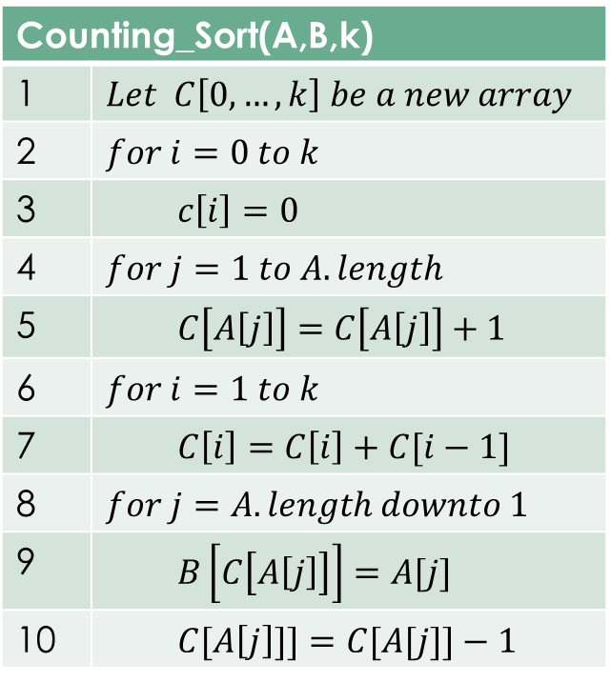
Counting_Sort(A,B,k)
1 | $$Let C\left[0,…,k\right] be a new array$$
2 | $$for i=0 to k$$
3 | $$c\left[i\right]=0$$
4 | $$for j=1 to A.length$$
5 | $$C\left[A\left[j\right]\right]=C\left[A\left[j\right]\right]+1$$
6 | $$for i=1 to k$$
7 | $$C\left[i\right]=C\left[i\right]+C[i−1]$$
8 | $$for j=A.length downto 1$$
9 | $$B\left[C\left[A\left[j\right]\right]\right]=A[j]$$
10 | $$C[A\left[j\right]]]=C[A[j]]−1$$

